Slide 1
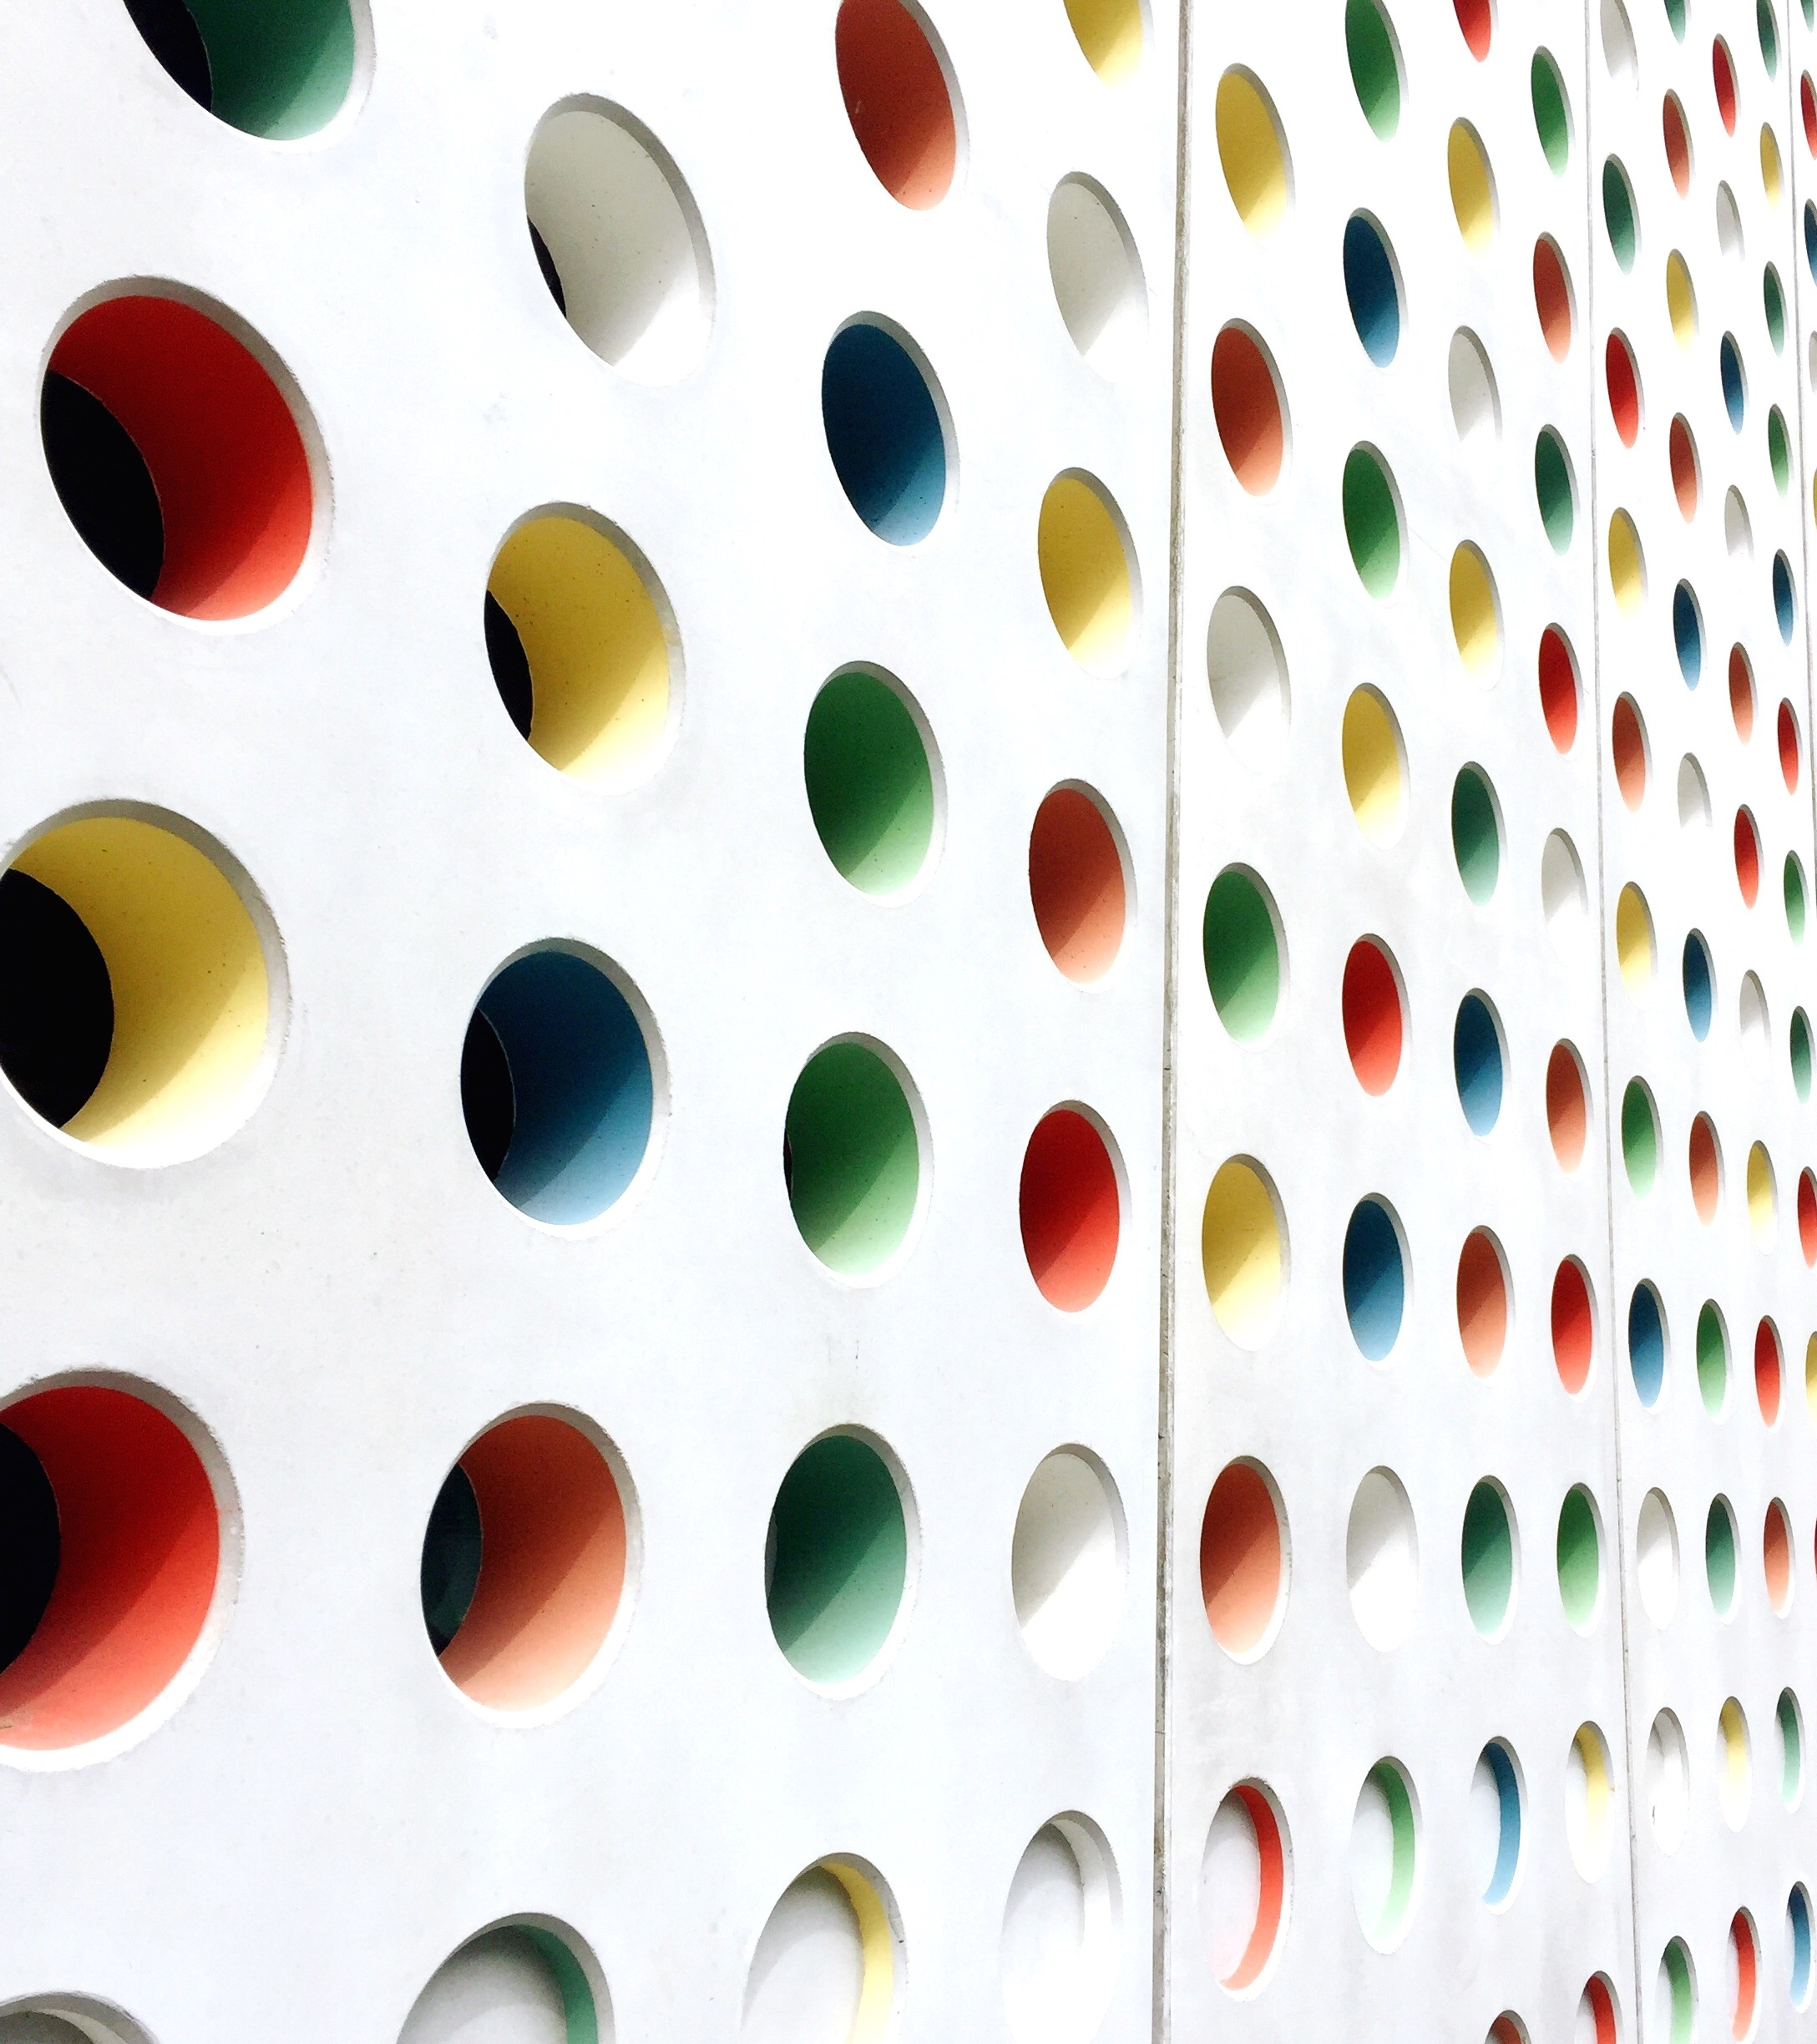
Project Report
Final Remarks

Slide 2
Why Securing Vision AI Matters Content
Problem:-
-AI image recognition systems are vulnerable to adversarial attacks.
-Small image modifications (noise or hidden perturbations) can fool AI into making incorrect --predictions.
-These attacks can affect security-critical applications.
Real-World Examples:-
🚗 Self-driving cars misreading traffic signs.*
🏥 Medical AI making incorrect diagnoses.*
🔐 Face recognition systems being bypassed.*
📹 Smart surveillance detecting the wrong objects.
roject Objective:-
Build a Vision AI system that detects adversarial attacks and restores AI prediction accuracy using defense techniques.

Slide 3
System Architecture
AI Adversarial Vision Benchmark:-
Explanation:
User uploads an image.
* Attack module generates an adversarial image.
* Defense module removes most of the attack
AI model predicts the object.
* Results are stored for benchmarking.
.

Slide 4
LIVE DEMO
Demonstration Flow :-
Step 1Upload a clean image.➡️ AI PredictionExample:CatConfidence: 99%
Step 2Apply Adversarial AttackNoise AddedPrediction becomesDogConfidence: 42%
Step 3Enable Defense FilterPrediction recoversCatConfidence: 93%
Explain During Demo
Upload image✔️
Click *Run Attack*✔️
Observe incorrect prediction✔️
Enable *Defense*✔️
Observe recovery✔️
Benchmark updated automatically ✔️

Slide 5
Benchmark Charts & Findings
Attack Impact:-
| Test | Accuracy |
|| Baseline | 95% | Under Attack | 38% | After Defense | 89%
Suggested Charts:-
Chart 1
Baseline Accuracy* Accuracy Under Attack* Accuracy After Defense
Chart 2
Attack Success vs Attack Failed* Defense Recovery vs Defense Failed
Findings:-
Attack reduced accuracy by approximately *57%*.* Defense restored accuracy to *89%*.* Blur and Median filters significantly improved prediction reliability.* Benchmark validated using *20 diverse images*.

Slide 6
Key Learnings & Future Enhancements
Key Learnings:-
* Vision AI is vulnerable to adversarial attacks.
* Simple perturbations can drastically reduce accuracy.
* Defense filters improve robustness.
* Benchmarking helps evaluate AI security.
* Streamlit provides an interactive evaluation interface.
Future Enhancements:-
* Deep Learning–based defense models.
* Support for additional attack techniques (FGSM, PGD, CW).
* Real-time webcam protection.
* Automated attack detection.
* Cloud deployment.

Slide 7
Conclusion
Conclusion:-
This project demonstrated how adversarial attacks can significantly reduce the accuracy of Vision AI systems and highlighted the importance of implementing effective defense mechanisms. By developing an AI Adversarial Vision Benchmark, we successfully evaluated attack impact, measured defense recovery, and visualized the results through benchmark metrics. The findings show that applying defense techniques can substantially improve the robustness and reliability of AI image classification systems.
for your time and attention. Thank you
Thank You!
**

